Slide 1
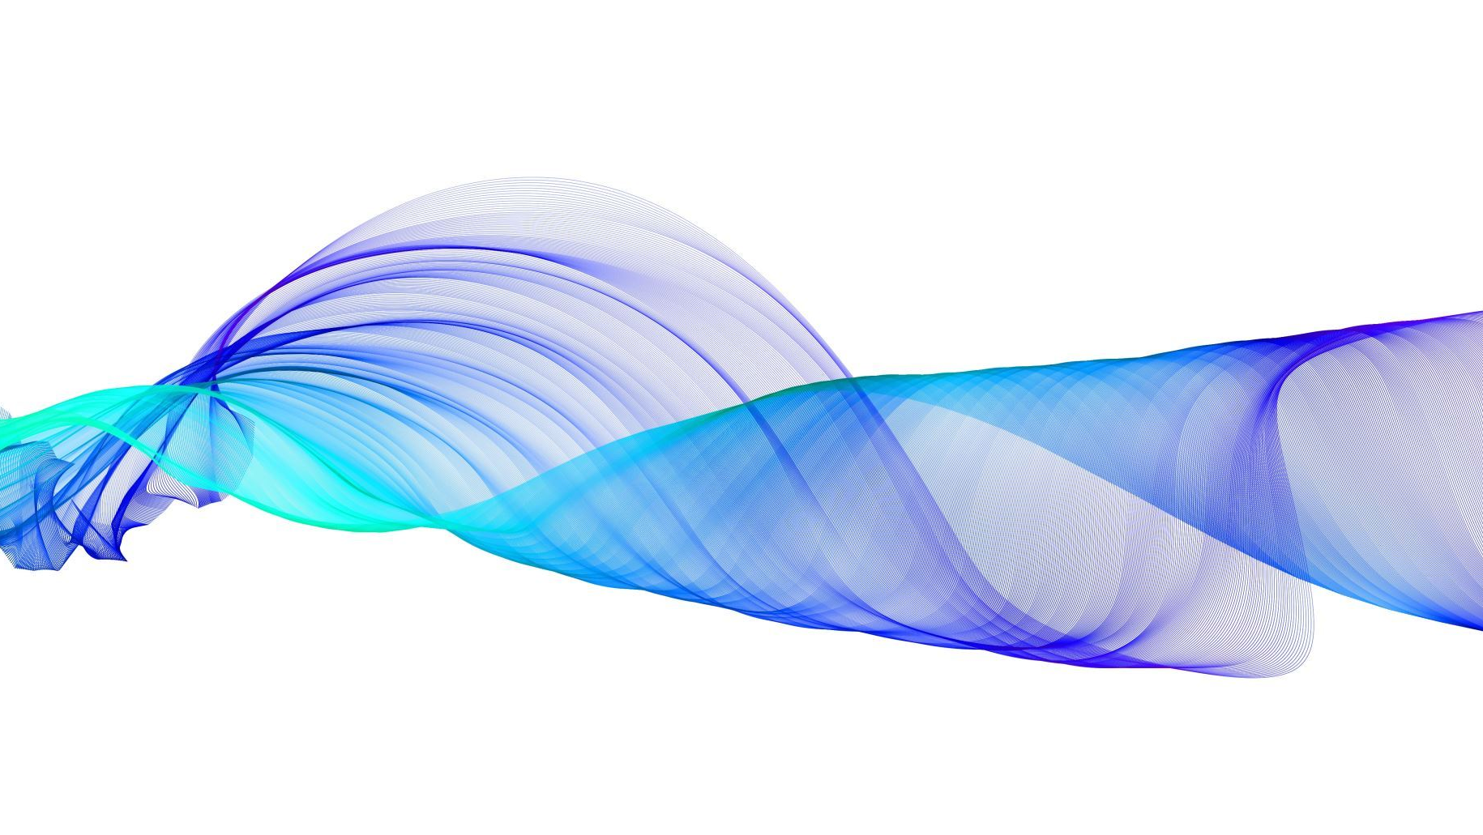
Content moderation when it comes to wikipedia hate comments
Adam Chao, Ethan Carty, Noor Sharaf, Connor Shaw, Will Shostak

Slide 2
Data basis for our AI model
- Dataset: Wikipedia comments that were hand rated/labelled by human raters
- 6 possible labels: toxic, severe toxic, obscene, threat, insult, and identity hate
- Comments can range from thanking someone to openly targeting a person or group of people i.e. "SHUT UP, YOU FAT ****, OR I WILL KICK YOUR ***!!!"
- We have tens of thousands of comments in the training set to help get our model where it needs to be
- Data is from an expired Kaggle competition that can be found here – Toxic Comment Classification Challenge: https://www.kaggle.com/competitions/jigsaw-toxic-comment-classification-challenge/data
*** dataset is not to be redistributed but may be used for "academic research and education, and other non-commercial purposes"

Slide 3
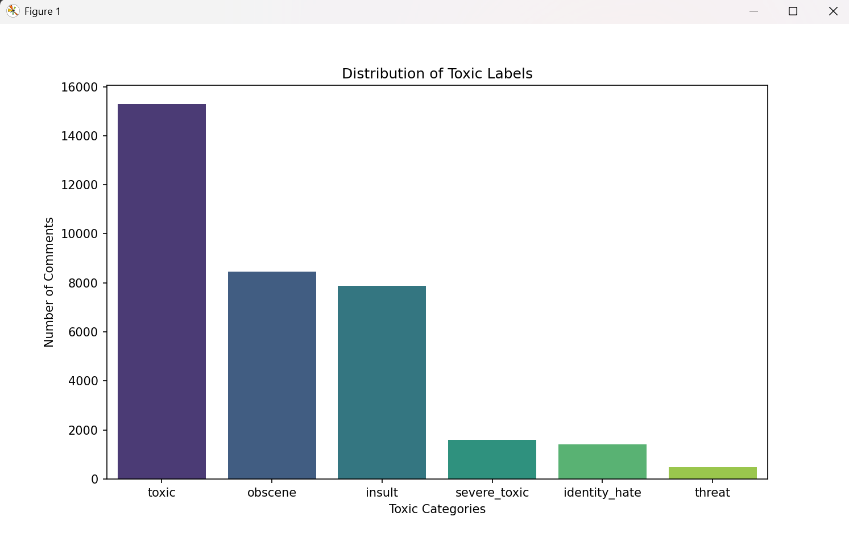
Visualization of our Current Data
- Using NumPy, Pandas, matplotlib, and seaborn able to filter through data and create chart with important labels
- Will be useful in training our AI to see what data we are working with

Slide 4
Where we are now
- Data has been cleaned and vectorized
- Currently working on coding/training the model
- Going to use Naïve Bayes Theorem to train our model so coding that now

Slide 5
Basic EDA of Vectorized Data
Clean_train: (159571, 8)
Clean_test: (153164, 2)
Vocabulary size: 54253
Train shape: (159571, 54253)
Test shape: (153164, 54253)
Train sparsity: 99.94644506221071%
Test sparsity: 99.95431233712866%
Train includes labels, test labels are separate file
159571 points in train, 153164 points in test (some are unlabeled and will be removed)
After vectorization, there is a vocabulary of 54253 features
Sparsity is high in text data because each document only contains a small selection of the vocabulary
Vectors are mostly zeros which is good for storage and efficiency

Slide 6
Our Current Proposed Project Timeline
12 Mar.
Progress Presentation
28 Mar.
Finish Training Model
4 Apr.
Evaluate Model with our given test set, create visuals
11 Apr.
Complete Ethical Analysis
29 Apr.
Finish Presentation and Technical Report
30 Apr.
Final Presentation
Notes:
Give about a week in between goals as after the model is trained it shouldn't be too hard to do the rest. Allotted for a few weeks for the model itself

Slide 7
Rationale for our Proposed Timeline
- Wanted to give more time for big deliverables such as the model training and the report writing
- Smaller milestones such as ethical analysis should be more straightforward to complete so we can get it done faster
- Wanted to have a large buffer toward the end to refine our presentation and hone our report so we have the best possible deliverable

Slide 8
Group Structure as a Whole
- We divide up the work within the current milestone to fit our needs
- Some milestones will have some group members do more work than others but in turn for other milestones those who did less at the start have to do more
- Have clear communication through our group chat to delegate who is doing what for the part we are working on
- This encourages active participation amongst the entire group for the entirety of the project rather than say having one person do one milestone then just not having to do anything for the rest of the time (Also spreads everyone's work out which is more equitable)

Slide 9
What We Hope to Gain/Achieve
- A better understanding of ML and how it will interpret what humans will percieve as inappropiate
- Learn ethical implications of training models that can affect users
- A better skillset to apply to hackathons/career

Slide 10
Thank you

